Slide 1
GROUP 3
MINI PROJECT PRESENTATION - 2

Slide 2
Cuffless Blood Pressure Estimation
Group members:
Sajio C S- MDL19EC105
Rizwan Mohammed – MDL19EC097
Syam Joseph – MDL19EC120
Aravind T S – LMDL19EC133

Slide 3
Contents
1.Introduction
2.Scope and objectives
3.Scientific feasibility
4.Literature survey
5.Methodology
6.Block diagram
7.Circuit diagram
8.Machine Learning Model
9.Results
10.Conclusion
11.Abbreviations
12.References

Slide 4
INTRODUCTION
Project demonstrates cuffless BP measurement
Continuous monitoring
ECG and PPG obtained through sensors in Arduino
Values sent to mobile application via Bluetooth module

Slide 5
Inputs from app, hit the API.
API contains pickled format of ML model.
ML model predicts the output and API returns it.
The app displays the predicted BP value
Real time ECG and PPG also available in the app

Slide 6
SCOPE
Continuous monitoring of blood pressure.
Useful in the sports industries for evaluation of their athletes.
Supporting mobile app helpful to users.
Provides healthy lifestyle tips.
Includes a breathing exercise.

Slide 7
RELEVANCE
Low product maintenance
Components-easily available.
Analyze sleep patterns, tension and stress levels.
Solutions for stress reduction.
Cost estimation-below 2K

Slide 8
OBJECTIVES
Make accurate BP estimations
Provide continuous BP measurements.
Implement an ML model for BP estimation
Integration with mobile application.
Mobile app to display BP, ECG and PPG.

Slide 9

SCIENTIFIC FEASIBILITY

Slide 10
Comprehensive overview of cuffless BP monitoring
Discusses its clinical relevance.
Superior method- predict cardiovascular events.
Asserts it as the most accurate method.
Integral to modern digital health platforms.
Advances in component miniaturization, chip design.

Slide 11
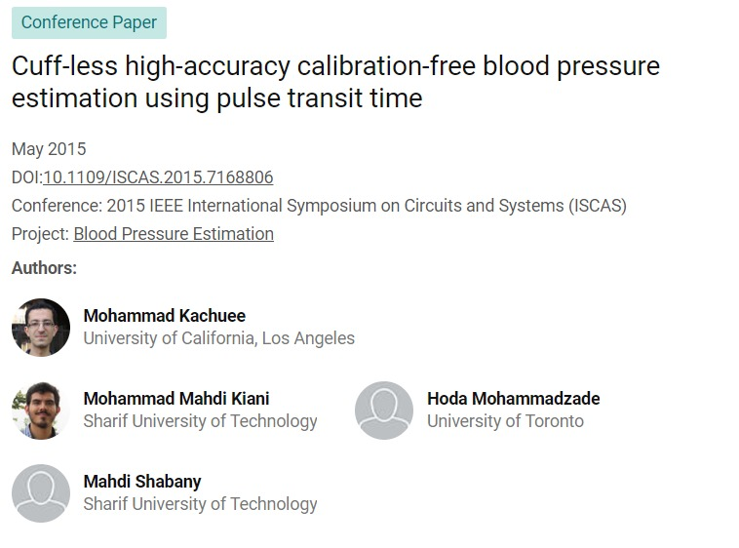
The given conference paper also depicts the relevance of our topic.

Slide 12
LITERATURE SURVEY
Serial No. | Published Year | Author | Topic | Methodology | Remarks
1. | 2020 | Yung-Hui Li, Latifa Nabila Harfiya, Kartika Purwandari and Yue-Der Lin | Real-Time Cuffless Continuous Blood Pressure Estimation Using Deep Learning Model | blood pressure estimation algorithm based on a deep learning model that contains BiLSTM (Bidirectional Long Short-Term Memory) in the first layer and followed by n layers of LSTM. Specifically, used residual connection for each LSTM layer with the input of seven features | The features are generated from the ECG signal or/and PPG signals

Slide 13
Serial No. | Published Year | Author | Topic | Methodology | Remarks
2 | 2020 | Syed Ghufran Khalid, Haipeng Liu, Tahir Zia, Jufen Zhang, Fei Chen, Dingchang Zheng | Cuffless Blood Pressure Estimation Using Single Channel Photoplethysmography: A Two-Step Method | This study aims to validate an innovative two-step method for PPG-based cuffless BP estimation. A combined database was derived from two online databases (Queensland and MIMIC II) to cover a wide range of corresponding BPs. In total, there were 18010 raw PPG signal segments (5 seconds for each) with corresponding BPs, separated into two halves for training and testing of algorithms. Each PPG signal segment was pre-processed to extract 16 signal features. Later, three significant features have been selected using multicollinearity test | The traditional generic (trained with uncategorized BP) algorithm and two-step algorithm (specifically optimized for each BP category) were developed using machine learning. Generally, the two-step algorithm achieved the AAMI/ISO standard in estimating systolic BP and diastolic BP.

Slide 14
Serial No. | Published Year | Author | Topic | Methodology | Remarks
3. | 2020 | Geerthy Thambiraj, Uma Gandhi, Umapathy Mangalanathan ,V. Jeya Maria Jose, M . Anand | Investigation on the effect of Womersley number, ECG and PPG features for cuff less blood pressure estimation using machine learning | New feature, Womersley number reflects the flow properties of blood is proposed for cuffless estimation of BP. Optimal feature set are derived using Genetic algorithm method and relevance between ECG features and BP is analyzed. Identifying the associations of ECG features with BP helps in selecting relevant features which minimize the computational cost as well as errors in the assessment of BP. | ECG time domain features along with PPG features outperforms the machine learning model trained with PPG features alone.

Slide 15
Serial No. | Published Year | Author | Topic | Methodology | Remarks
4. | 2021 | Sen Yang, Yaping Zhang, Siu-Yeung Cho, Ricardo Correia & Stephen P. Morgan | Non-invasive cuff-less blood pressure estimation using a hybrid deep learning model | Before application of machine learning algorithms, the ECG and PPG are pre-processed and features are extracted. Several popular machine learning algorithms are then applied to estimate BP from signal features and physical characteristics. | Unlike traditional methods, the proposed deep learning method does not require feature extraction and key information contained in the raw data are automatically extracted by the deep learning network by self-learning.

Slide 16
METHODOLOGY
Components- ECG sensor, PPG sensor, Bluetooth module,
Arduino uno and a Smartphone.
ECG sensor – (AD 8232 ECG sensor ) to get the ECG signal.
Pulse sensor module – to get the ppg signal
Bluetooth module – (HC – 05 ) to send the ECG and PPG values to Smartphone.

Slide 17
Arduino uno – Get the signals from ECG , PPG sensors send it to smartphone through Bluetooth module.
Smartphone-Collects the signals and pass it to the API and predicts the BP
-Also shows ECG and PPG readings

Slide 18
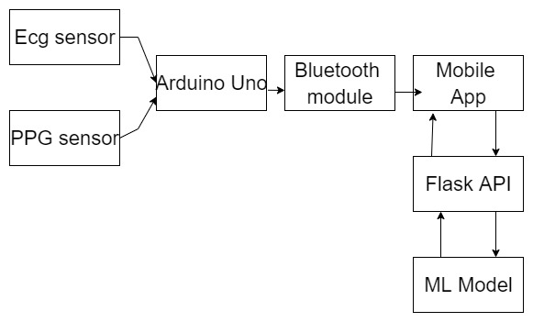
BLOCK DIAGRAM

Slide 19
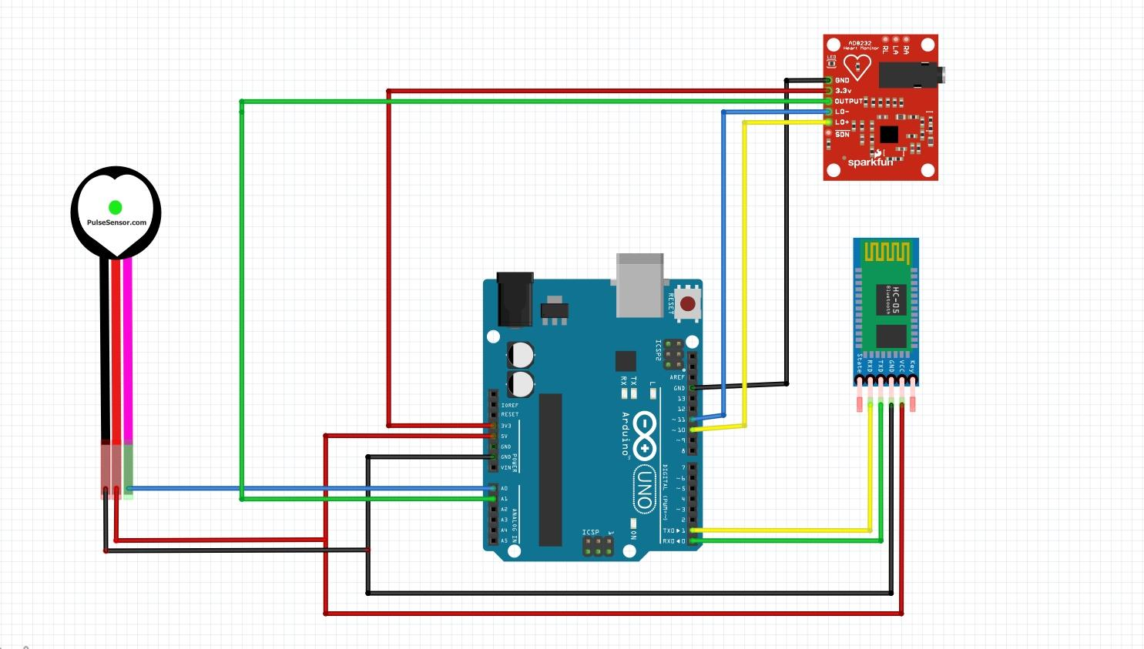
CIRCUIT DIAGRAM

Slide 20
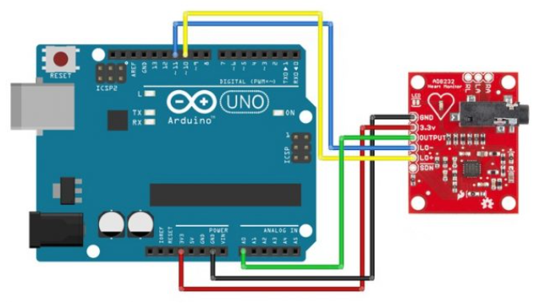
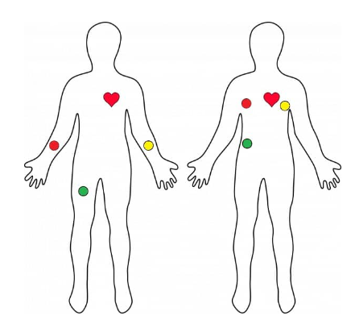
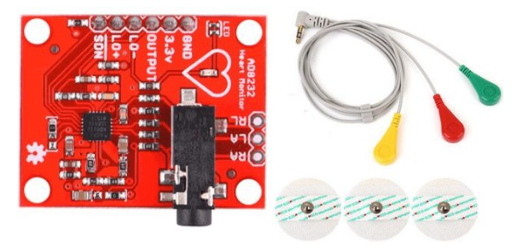
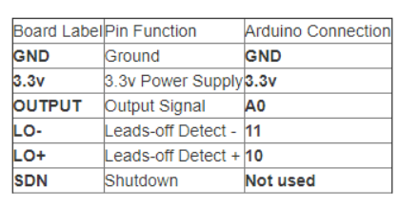
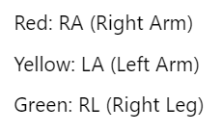
ECG sensor – (AD 8232 ECG sensor )

Slide 21
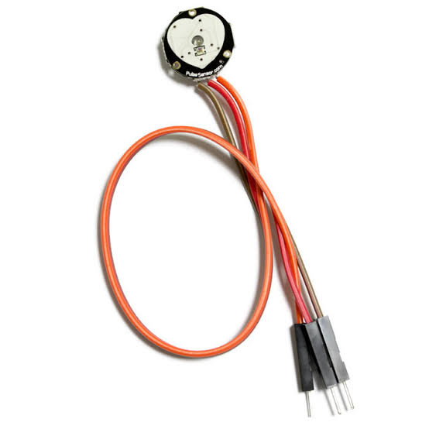
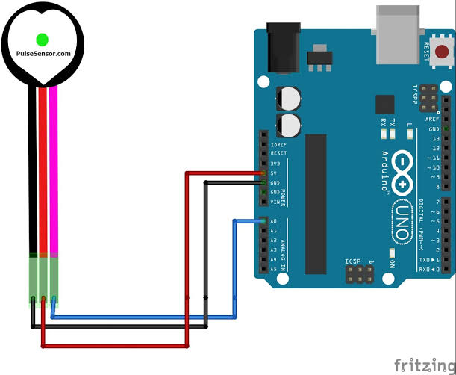
Pulse Sensor Module

Slide 22
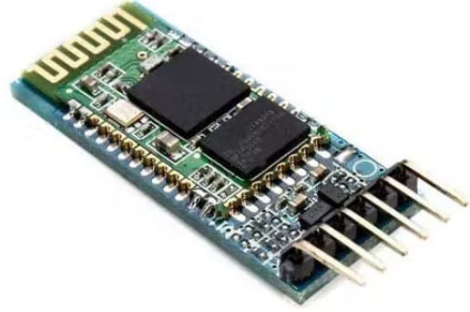
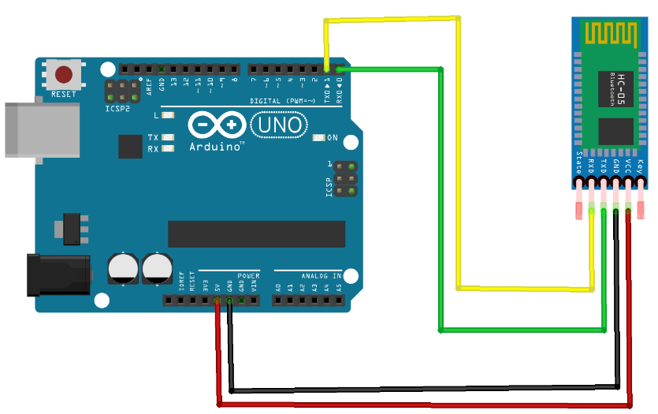
Bluetooth module – (HC – 05 )

Slide 23
Machine Learning Model
Integrated with mobile application.
Uses MIMIC dataset.
Contains ECG, PPG and BP values(12,000 values).
Input values are normalized.
Dataset is split and used to train the ML model.
Trained ML model predicts BP based on ECG and PPG values.

Slide 24
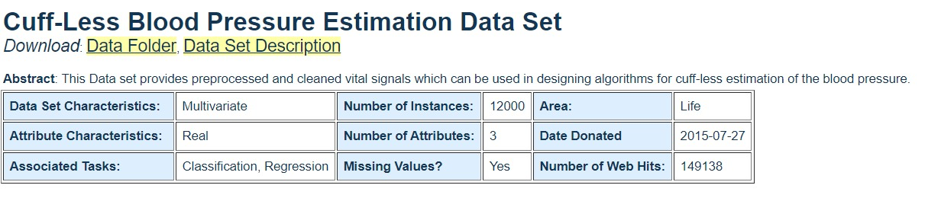
Provides clean and valid signals for designing cuff-less blood pressure estimation algorithms.
ECG, PPG and ABP signals are originally collected from the physionet.org
Some preprocessing and validation performed on them.

Slide 25
Attribute Information
The data set is in matlab's v7.3 mat file.
This database consist of a cell array of matrices, each cell is one record part
In each matrix each row corresponds to one signal channel:
1: PPG signal, FS=125Hz; photoplethysmograph from fingertip
2: ABP signal, FS=125Hz; invasive arterial blood pressure (mmHg)
3: ECG signal, FS=125Hz; electrocardiogram from channel II

Slide 26
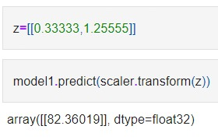
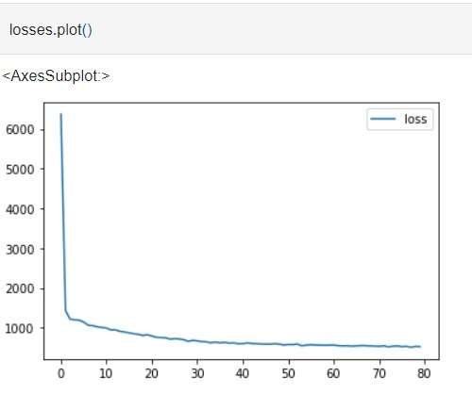
Predicted BP value.
Loss function of our model

Slide 27
COST ANALYSIS
SL NO | COMPONENT | QUANTITY | PRICE(INR)
1. | Arduino UNO | 1 | 643
2. | ECG Sensor | 1 | 210
3. | Pulse Sensor Module | 1 | 180
4. | Bluetooth Module | 1 | 330

Slide 28
RESULTS
ECG and PPG values are obtained.
Values displayed in the mobile application.
Estimated BP value is shown

Slide 29
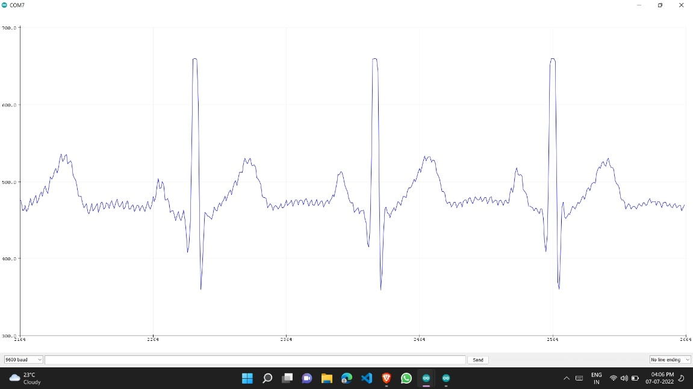
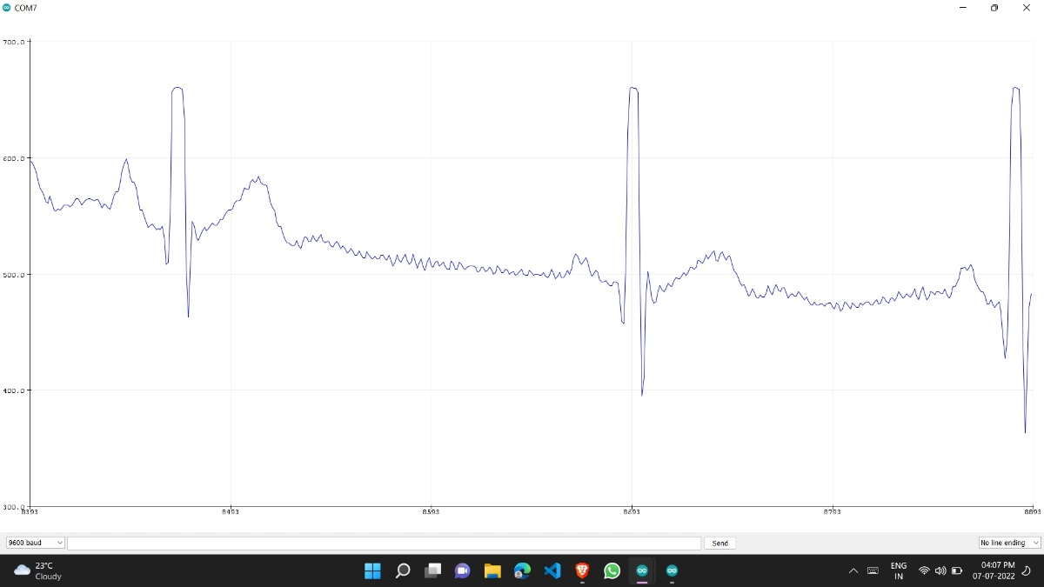
1. ECG output values

Slide 30
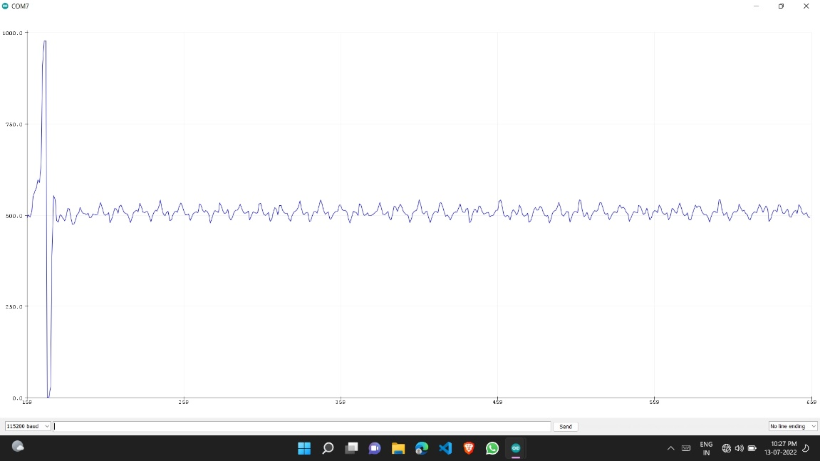
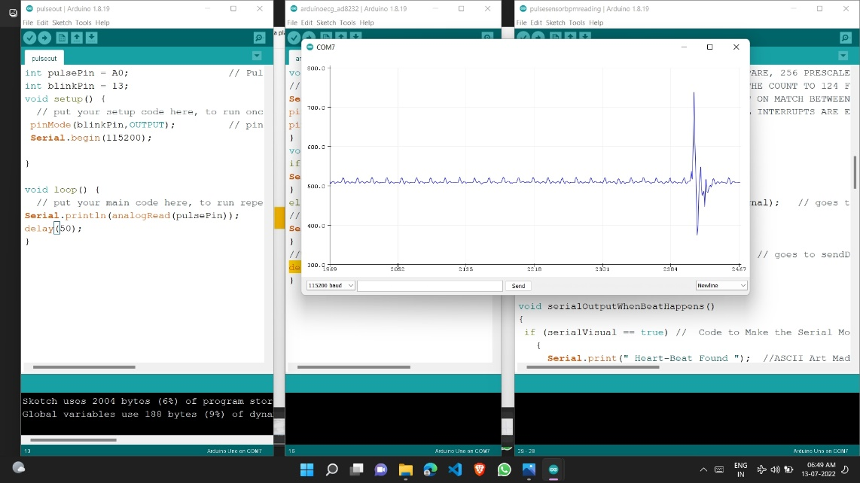
2. Pulse sensor output values

Slide 31
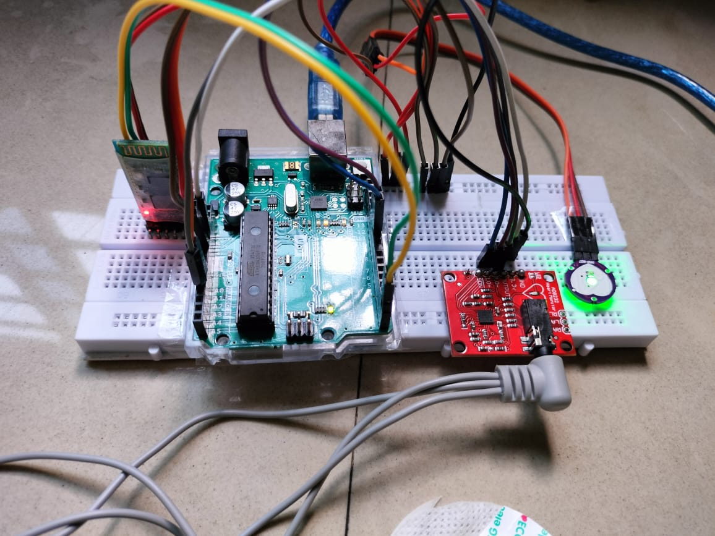
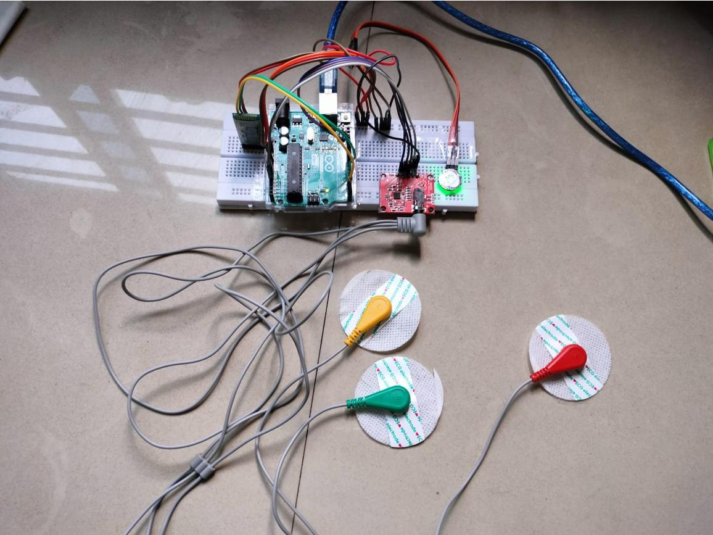
3. Circuit setup

Slide 32

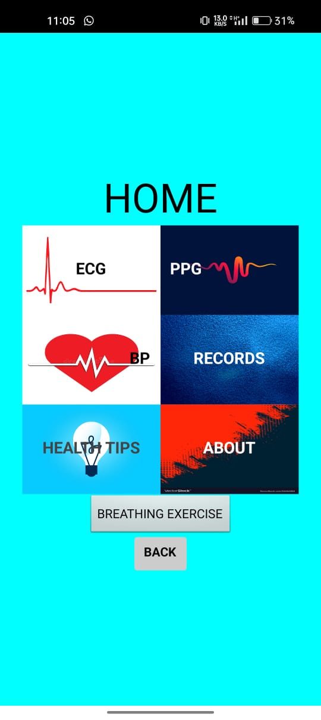
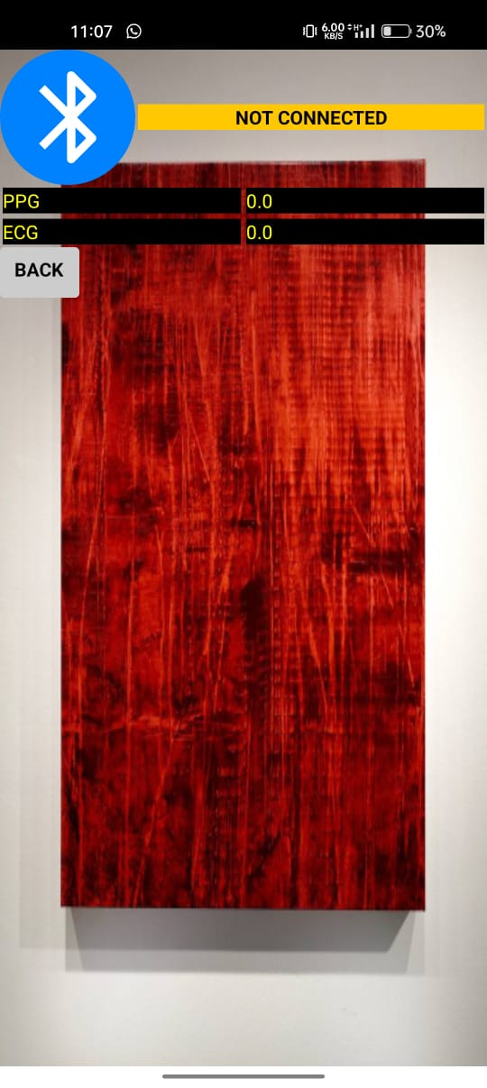
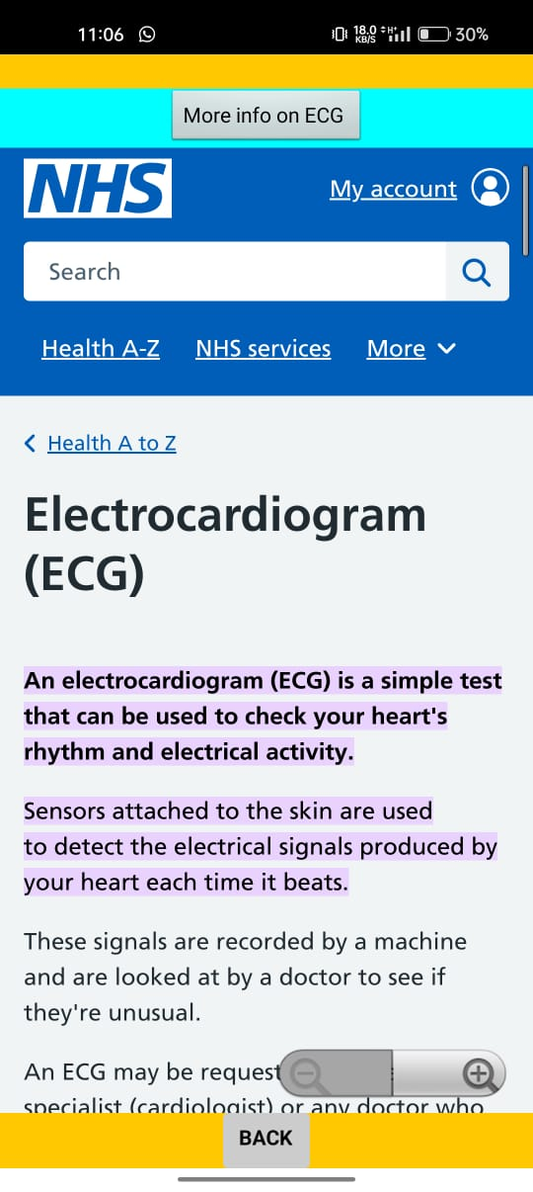
4. Mobile app design

Slide 33
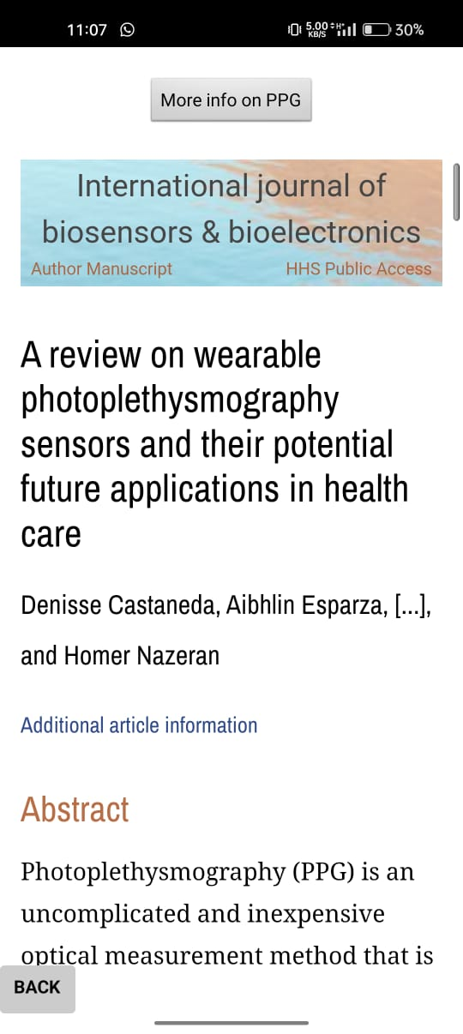

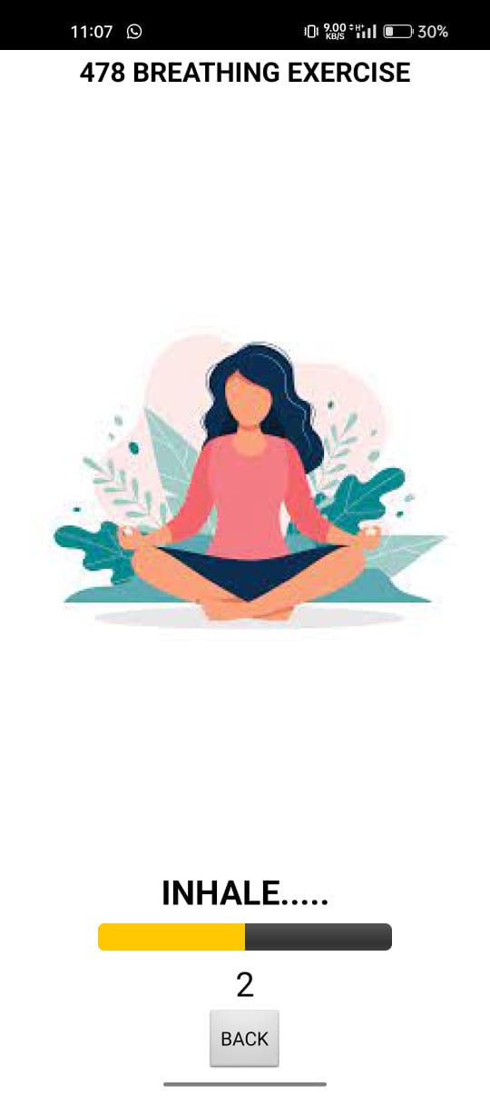


Slide 34
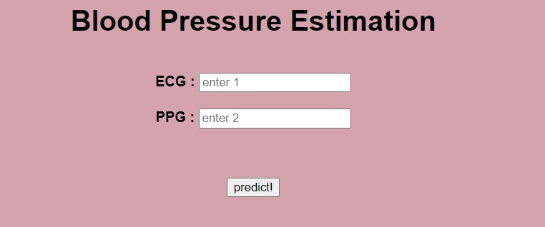
Website Interface

Slide 35
CONCLUSION
Cuffless BP estimation using arduino uno and required sensors is proposed
Allows continuous monitoring of BP.
BP estimated using a trained ML model.

Slide 36
ABBREVIATIONS
BP – Blood pressure
ECG - Electrocardiogram
PPG – Photoplethysmography
API – Application programming interface
AAMI- Association for the Advancement of Medical Instrumentation
ISO- International Organization for Standardization

Slide 37
REFERENCES
[1] Y.-H. Li, L. N. Harfiya, K. Purwandari, and Y.-D. Lin, “Real-Time Cuffless Continuous Blood Pressure Estimation Using Deep Learning Model,” Sensors, vol. 20, no. 19, p. 5606, Sep. 2020, doi: 10.3390/s20195606.
[2] S. G. Khalid, H. Liu, T. Zia, J. Zhang, F. Chen and D. Zheng, "Cuffless Blood Pressure Estimation Using Single Channel Photoplethysmography: A Two-Step Method," in IEEE Access, vol. 8, pp. 58146-58154, 2020, doi: 10.1109/ACCESS.2020.2981903.
[3] Geerthy Thambiraj, Uma Gandhi, Umapathy Mangalanathan, V. Jeya Maria Jose, M. Anand, ”Investigation on the effect of Womersley number, ECG and PPG features for cuff less blood pressure estimation using machine learning”,Volume 60, 2020,101942,ISSN 1746-8094. https://doi.org/10.1016/j.bspc.2020.101942.
[4] Yang, S., Zhang, Y., Cho, SY. et al. ”Non-invasive cuff-less blood pressure estimation using a hybrid deep learning model. ”Opt Quant Electron 53, 93 (2021). https://doi.org/10.1007/s11082-020-02667-0

Slide 38
[5] M. Kachuee, M. M. Kiani, H. Mohammadzade, M. Shabany, Cuff-Less High-Accuracy Calibration-Free Blood Pressure Estimation Using Pulse Transit Time, IEEE International Symposium on Circuits and Systems (ISCAS'15), 2015.
[6] A. Goldberger, L. Amaral, L. Glass, J. Hausdorff, P. Ivanov, R. Mark, J.Mietus, G. Moody, C. Peng and H. Stanley, Physiobank, physiotoolkit,and physionet components of a new research resource for complex physiologic signals,Circulation, vol. 101, no. 23, pp. 215“220, 2000.

